Slide 1

MUSIC HOST INTERFACE
BEng. Hons. Computer And Electronic Engineering, GMIT
Student: Thomas Flynn
Supervisor: Brian O’ Shea

Slide 2
Contents
Background
Tools
JavaFX Overview
Azure SQL database
JavaFX Music Host Application
Bluetooth
Android Application
Time Log
Conclusion

Slide 3
Background
Personal
Demonstrate Abilities
Realization of Ideas
Initial Idea
Virtual Jukebox
Complete Idea
Music Host dictates what the guests can do.
The guest can...
-Request songs
-Skip songs
-Give the DJ feedback

Slide 4



Tools
JavaFX
Scene Builder
Media API
Microsoft Azure Cloud Storage
User Login Credentials
User Songs
Bluetooth
BlueCove library
Android Bluetooth API

Slide 5









System Block Diagram
+
TDS
SQL Server
SQL Client
Audio Output
SDP Server
SDP Client

Slide 6
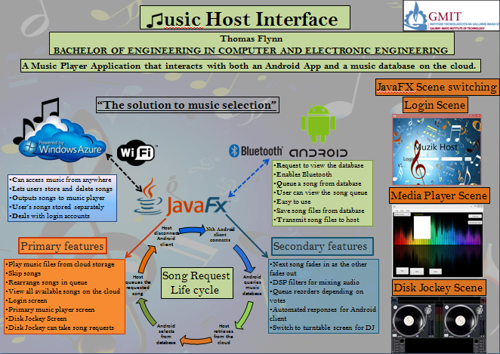
Christmas Project Poster

Slide 7

JavaFX Overview
JavaFX is intended to replace Swing as the standard GUI library for Java SE.
Swing interoperability- Existing Swing applications can be updated with new JavaFX features.
FXML is an XML-based declarative markup language for constructing a JavaFX application user interface.
Scene Builder generates FXML markup that can be ported to an IDE where a developer can add the business logic.

Slide 8
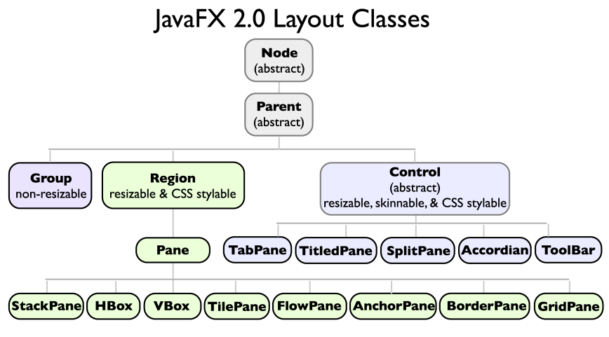
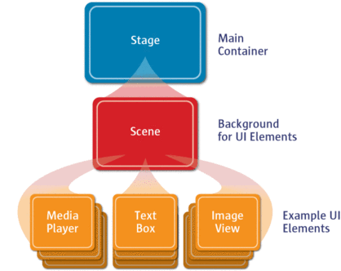
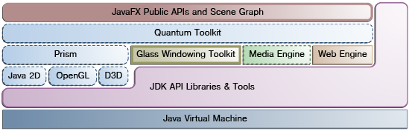
JavaFX Overview
Stage.
Scene Graph.
Node.
Includes graphics primitives.
JavaFX application thread.
Media thread.

Slide 9
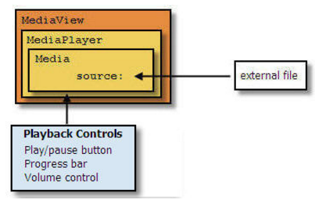
Media in JavaFX
Media classes are part of javafx.scene.media package.
Media, MediaPlayer and MediaView
MediaView is a Node, it has a MediaPlayer.
MediaPlayer has a Media object.
MediaTimers allow functions to be invoked at key points in Media.

Slide 10
Microsoft Azure SQL Database
Cloud based service (DBaaS)
Special version of Microsoft SQL Server as its backend.
XML based format for data transfer.
T-SQL as the query language.
Tabular Data Stream (TDS) as the protocol to access the service over the Internet.

Slide 11
Microsoft Azure SQL Database
Minimum Driver Version: Microsoft JDBC Driver 4.0
Driver = com.microsoft.sqlserver.jdbc.SQLServerDriver
Server= jdbc:sqlserver://muzikhostserver.database.windows.net:1433;"
Database = FYP
User = thomas11811@muzikhostserver
Password = Zqlllx$8

Slide 12
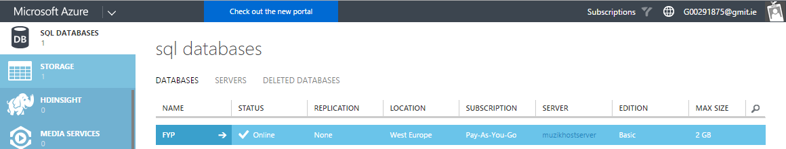
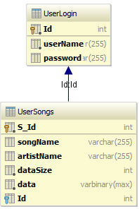
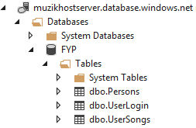
Microsoft Azure SQL Database
Server
Database

Slide 13
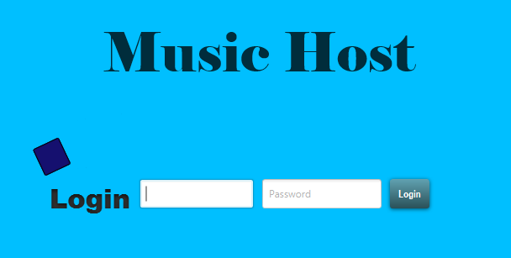
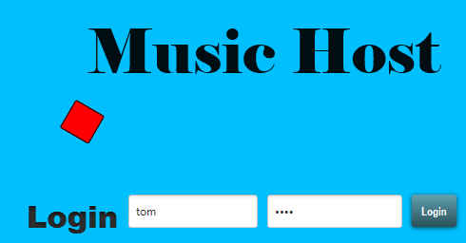
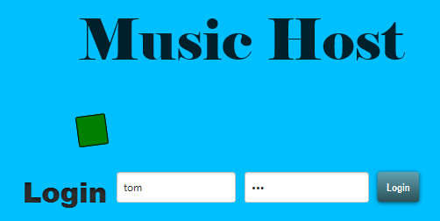
Music Host - Login Screen
Login Credentials
Success/Fail
Animation
Login Button
Fail
Animation
Success
Animation

Slide 14
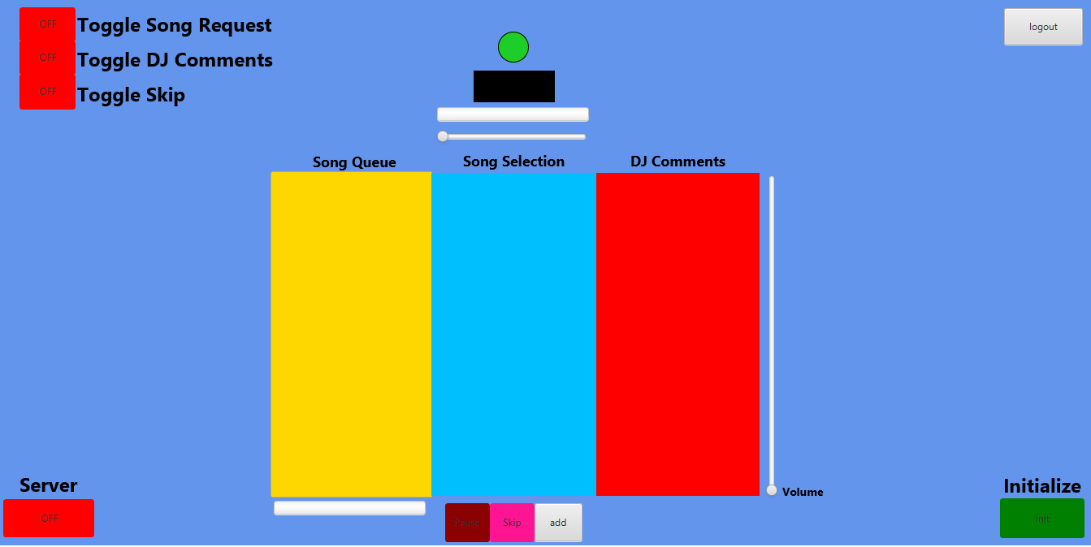
Music Host - Main Screen
Play Animation
Logout Button
Host Options
MediaView
Time Slider
Server Button
Download
Progress
Play, Skip, Add, Buttons
Volume Control
Start Button

Slide 15
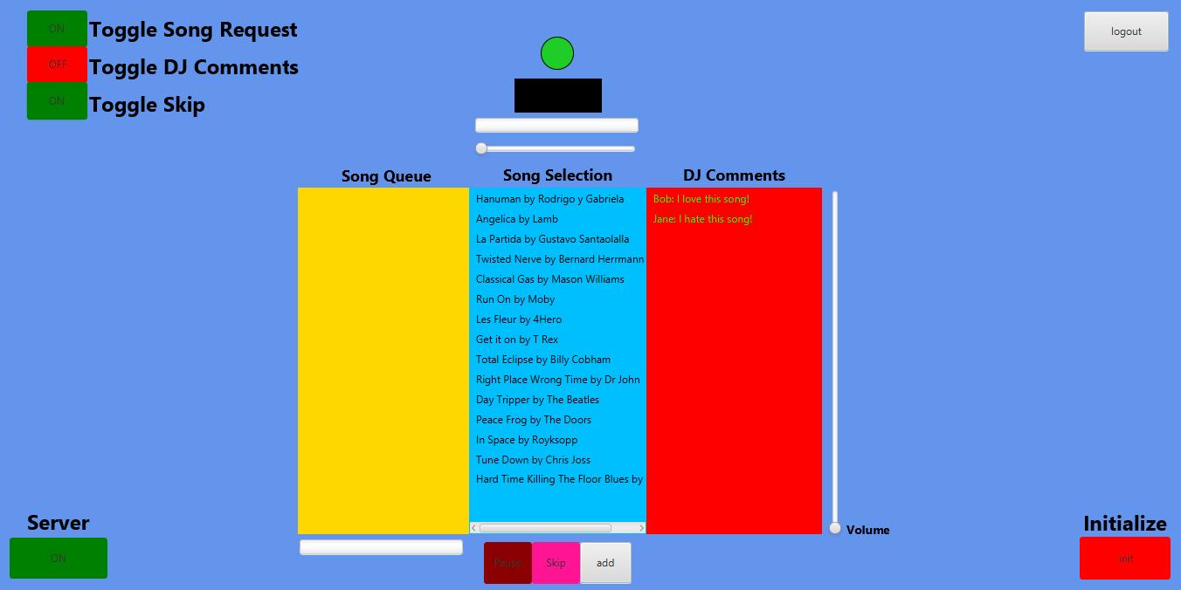
Music Host Use Case – Setup
Guest Options Specified
Server Enabled
Selection Populated
Initialized

Slide 16
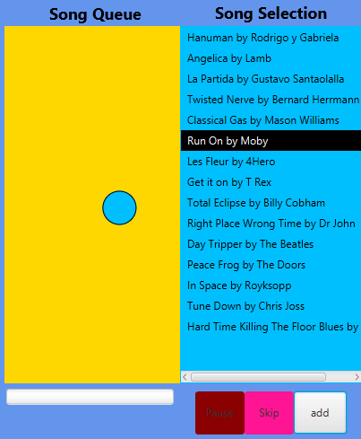
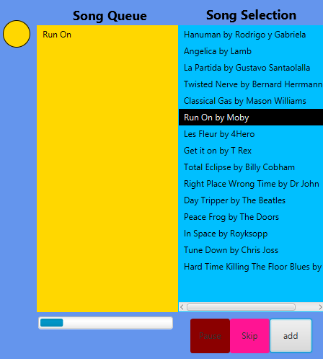
Music Host Use Case - Song Added
Animation Complete
Song added
Animation
Download Started
User Clicks

Slide 17
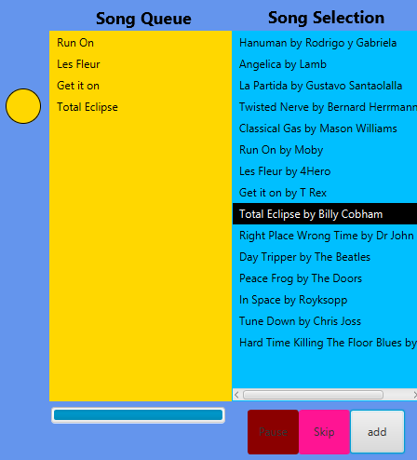
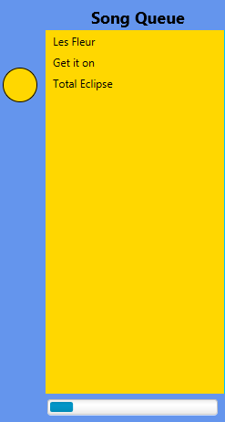
Music Host Use Case - Song Skipped / Song Ended
Next Song Plays
Circle Moves Up
Event Fired
Next Next Song Downloads

Slide 18
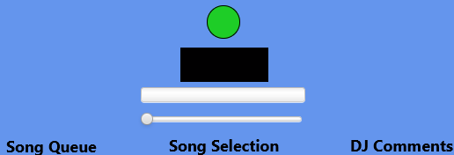
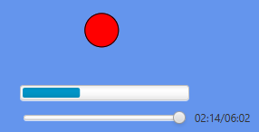
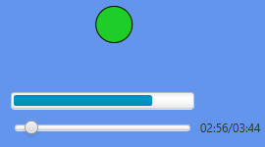
Music Host Use Case – Play / Pause
Animation Not
Started
MediaView Empty
Animation Paused
Animation Playing

Slide 19
System Block Diagram
+
TDS
SQL Server
SQL Client
Audio Output
SDP Server
SDP Client

Slide 20
Bluetooth Server
Profile: Serial Port Profile
One connection at a time.
Service discovery procedure has to be performed to set up an emulated serial cable connection.
Devices are paired during the connection establishment phase.
Link establishment is initiated by Android Client.
There are no fixed master slave roles.
RFCOMM is used to transport the user data, modem control signals and configuration commands.

Slide 21
SERIAL PORT PROFILE CONNECTION
SDP Client
1.1 Submit a query using SDP.
SDP Server
2.1 Request a new L2CAP channel.
1.2 Authentication procedure.
3.1 Initiate an RFCOMM session.
2.2 Accept a new L2CAP channel.
4.1 Start a new data link connection on the RFCOMM session.
3.2 Accept an RFCOMM session establishment on that channel.
4.2 Accept a new data link connection on the RFCOMM session.

Slide 22
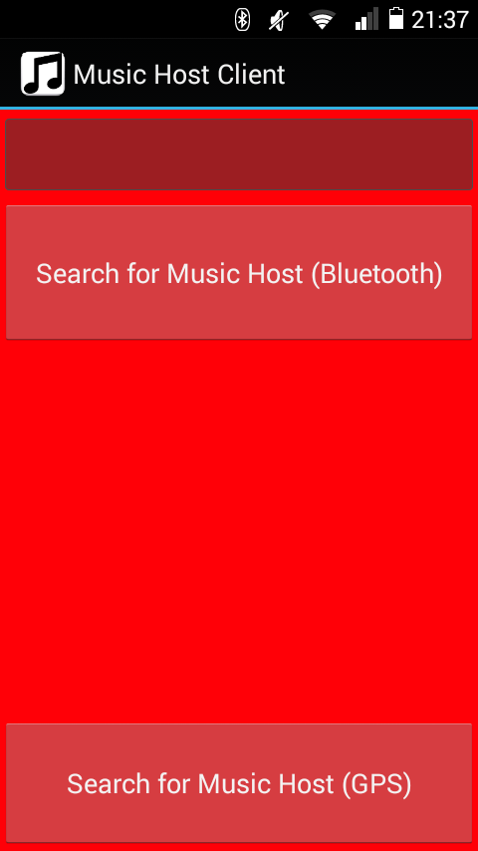
Music Host Client Use Case – Open App
Edit TextField
DJ Comment
Button
BT Adaptor.startDiscovery
Song Request,
DJ Comment,
Skip Song
Invisible Buttons
Button
Azure Mobile Services

Slide 23
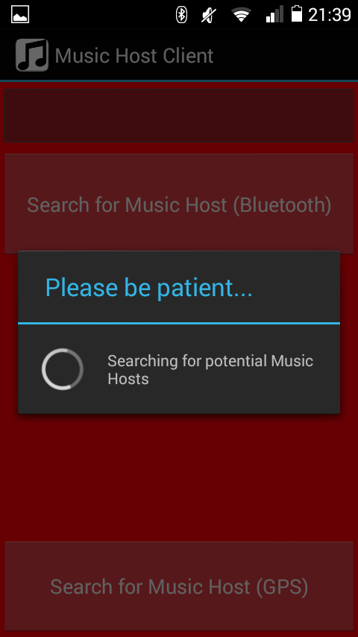
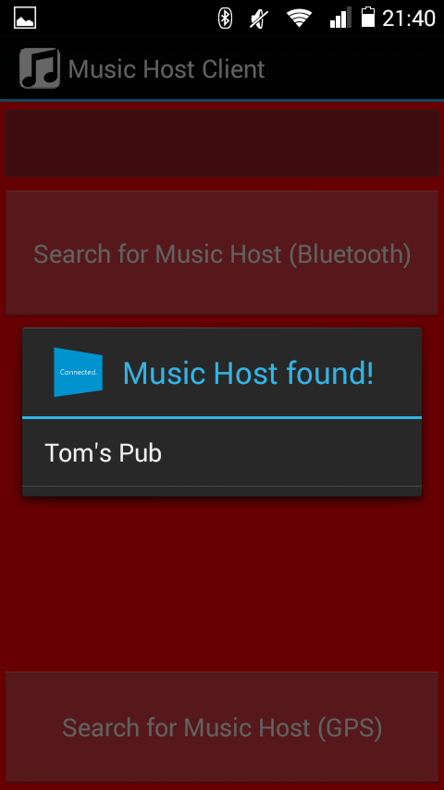
Music Host Client Use Case – Search For Music Host (BT)
Music Host Found

Slide 24
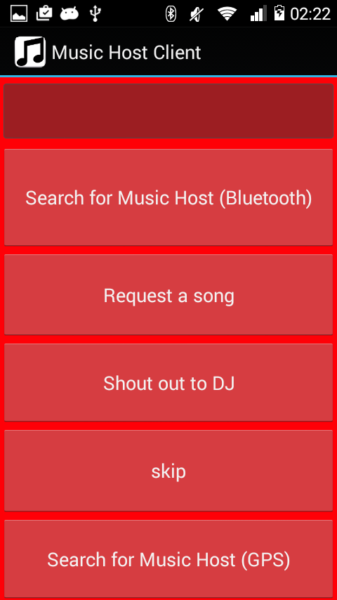
Music Host Client Use Case – Connected
Edit TextField
DJ Comment
Button
Send SONG_SELECT int
Button
Send DJ_COMMENT int
Button
Send SKIP_SONG int

Slide 25
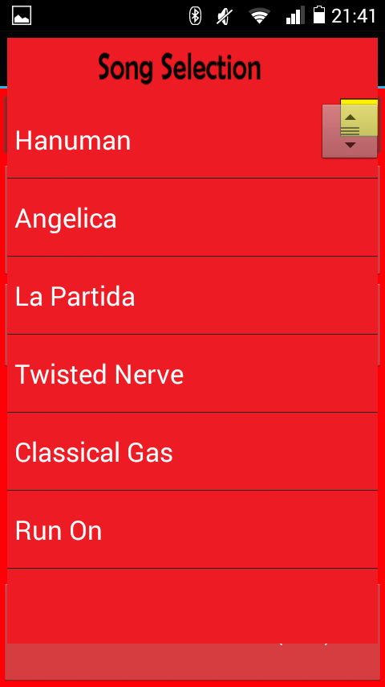
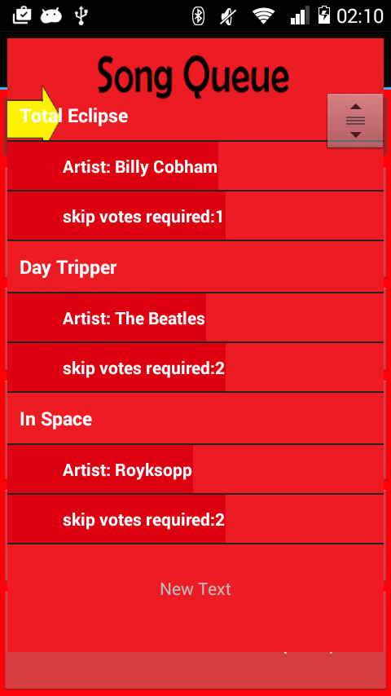
Music Host Client Use Case – Song Request
Selected
Song
Swipe
Left
Right
ViewFlipper Child 1
ViewFlipper Child 2

Slide 26
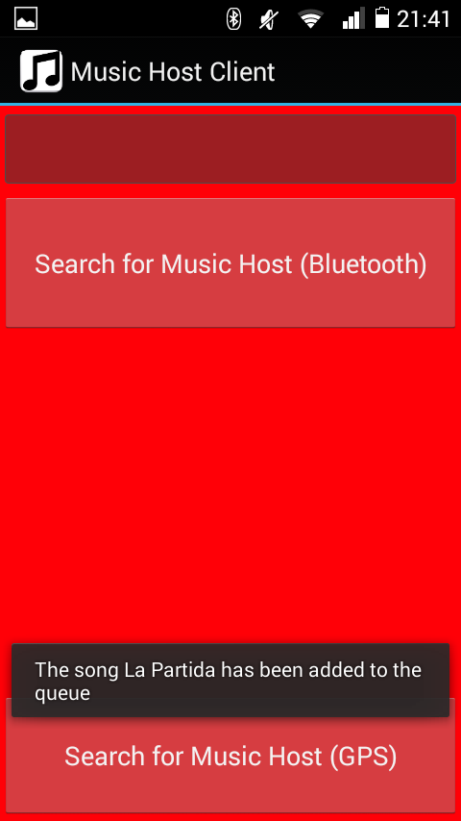
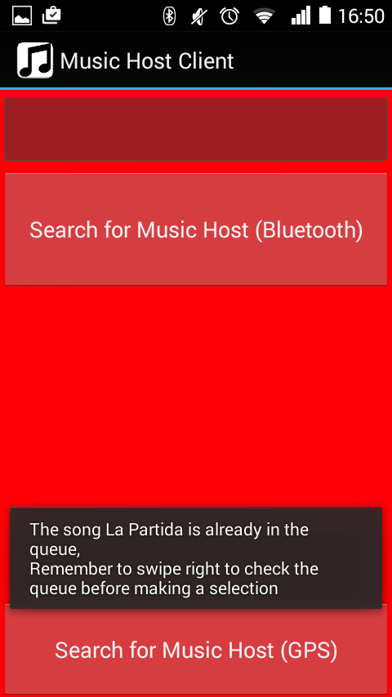
Music Host Client Use Case – Song Accepted / Not Accepted
Message From Host

Slide 27
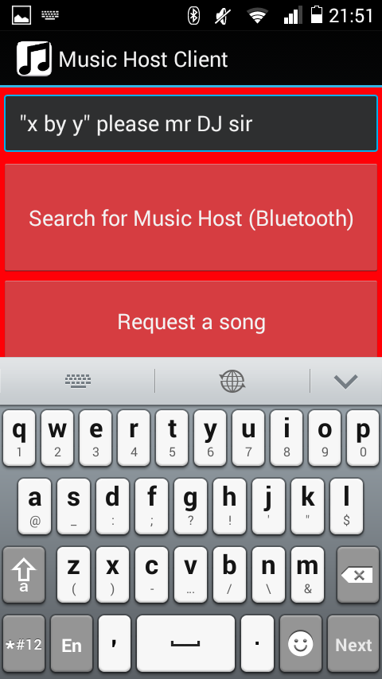
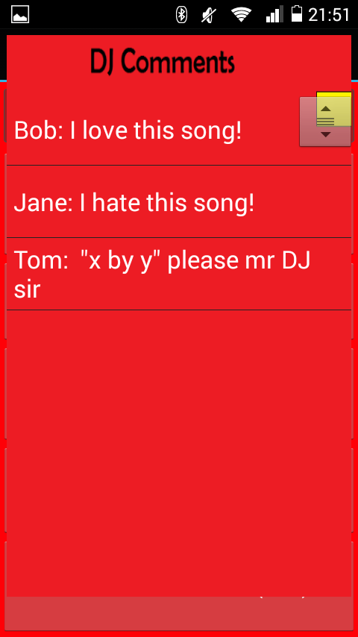
Music Host Client Use Case – DJ Comment
Button Clicked

Slide 28
Music Host Client Use Case – SKIP SONG
Skip votes required decremented
Button Clicked

Slide 29

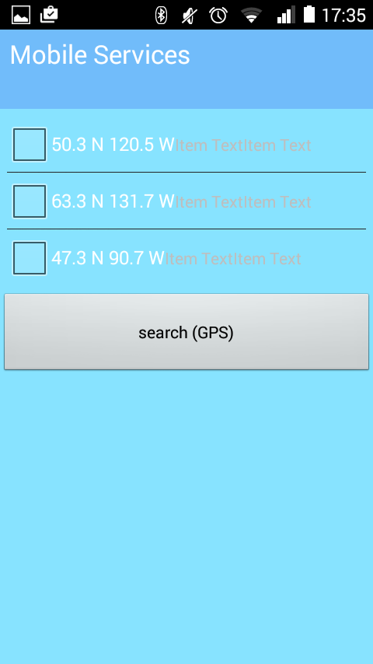
Music Host Client Use Case – Search For Music Host (GPS)
Progress Widget
Search Button
GPS Coordinates
Result

Slide 30
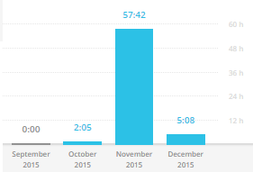
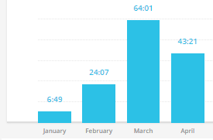
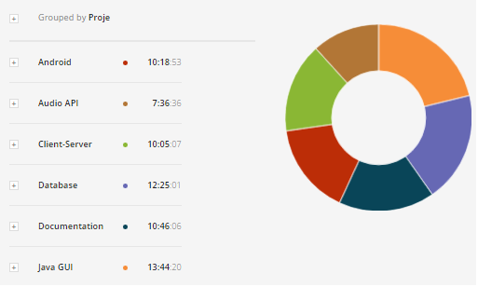
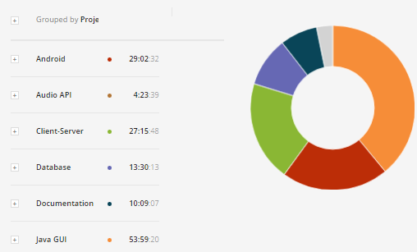
Time Log
September - December
January - April
Total = 64:45:03
Total = 138:20:39

Slide 31
Conclusion
Goals
Demonstration of abilities.
Develop programming skills.
Reflection
More focus on Client/Server Protocol.
Develop for local song files.
Develop for Wi-Fi instead of Bluetooth.
Conclusion
Project is a product of my abilities and personality.

Slide 32
References
github.com/acaicedo/JFX-MultiScreen
github.com/marcuspimenta/Chat-Bluetooth
bluecove.org
https://manage.windowsazure.com/gmit.ie#Workspaces/MobileServicesExtension/apps/MusicHostService/dashboard
https://manage.windowsazure.com/gmit.ie#Workspaces/SqlAzureExtension/SqlServer/muzikhostserver/Database/5.muzikhostserver/Dashboard

